Slide 1
ONLINE PEACE TAILORING SHOPPING STORE
By Sylvia Yvonne Onserio
Reg No : 17s03adit018
Supervisor : Ambrose Njeru

Slide 2
Introduction
This project sets it focus on the online shopping clothing stores
There are several online stores in the country that deal with clothing but most of them focus on single gender specification.
My research on the emerging trends in online shopping and fashion exposed me to a few weaknesses that exist in the current shopping stores.
My projects will be focused on coming up with a system that is an improvement of the current systems and also takes advantage of the current systems that are already in place.
This system will help better the shopping experience by taking into consideration the both the shoppers and the individuals in the store who make the system work.

Slide 3
Research Problem
Shopping for clothes is a process that takes a lot of time and also cost in terms of travelling to the market and making the purchases.
This traditional set up leaves the shopper only exposed to clothing from shopping stores within their own locality.
Time also being a constraint will mean that the shopper will not be able to make purchases within the desired period due to tight schedules.
The clothing designers also don’t get to interact with a wider customer base hence their sales and market potential is also limited.
A system is therefore required that will enable both designers and shoppers to overcome this limitations.

Slide 4
Reasearch Objectives
A research on current online stores was carried out with an aim of finding out the following:
How the current online stores work
What is the business model that are used
Who are the contributing parties that make online shopping
What are the major is weaknesses that exist
How can the systems can be made more efficient to improve customer experience.

Slide 5
Research Questions
The research on online and traditional shopping stores was carried out with the following stores in mind:
How does online shopping work in general stores.
What are the various business models that are placed in the working of the online stores.
Who are the specific group of individuals that make up the structure of the online shopping stores.
What are the major issues facing the current list of stores and how they can be addressed.
How can the shopping experience be enhanced and by what additional feature.

Slide 6
Literature Review
During my research I was able to come up with detailed information on how the online stores worked and their business models that they.
The information on the online shopping stores also enabled the determing the various parties involved in online shopping and their individual roles in the system.
While focusing on online shopping stores which dealt in clothing I was also able to carry out a review on the following shopping stores
Mimi Kenya Online Shopping stores
Jumia online shopping Store
Mama Mike’s Online Shopping store

Slide 7
Methodology
My research mainly employed the use of quantitative design techniques in order to gather data about people and their experience and expectations they have while shopping online for clothes.
My main quantitative tool of research was the use of a questionnaire.
A questionnaire was developed and distributed among random individuals within and away from the campus environment with an aim of collecting data on their feedback concerning online clothing stores.
The data was then analyzed and conclusions drawn from them on rhe peoples opinion on online shopping and the type of improvements that they hoped to see takes place.

Slide 8
Methodology (cont…)
Apart from the questionnaires, online articles served a great deal in offering information concerning the topic at hand.
A visit to the websites that dealt with the same business was also of great use to the research because it exposed me to the various business models used by the different stores to achieve their purpose.

Slide 9
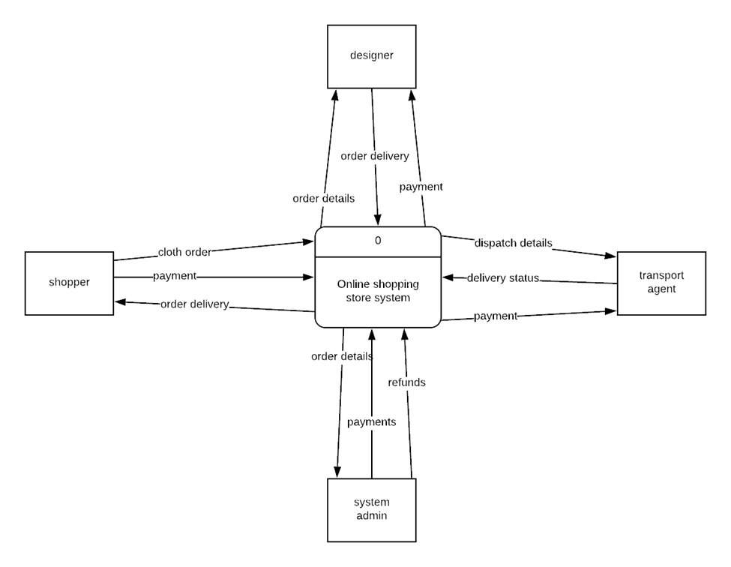
Design
Context Diagram

Slide 10
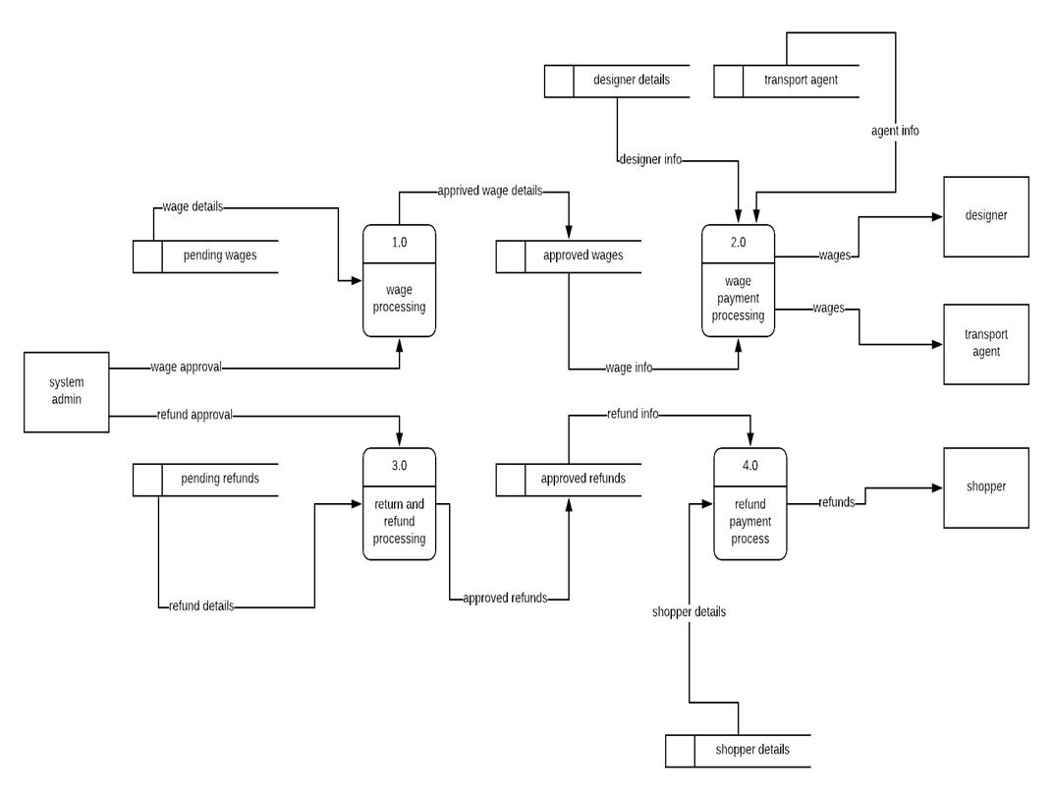
Design(cont…)
Level 0 DFD

Slide 11
Project Work Plan
The Gantt chart below gives the project activity plan.
Task | Task name | Planned hours | Start date | Finish date | September |  |  |  | October |  |  |  | November
1 | Problem definition | 10 | 10/09/2018 | 14/09/2018
2 | Requirement analysis | 10 | 17/09/2018 | 21/09/2018
3 | System design | 15 | 24/09/2018 | 3/10/2018
4 | System coding | 80 | 8/10/2018 | 23/11/2018
5 | Testing and debugging | 10 | 26/11/2018 | 30/11/2018
6 | Deployment and maintenance | 6 | 30/11/2018 | 3/12/2018
7 | Documentation | 120 | 17/09/2018 | 30/11/2018

Slide 12
Conclusions
This project will at the end contribute towards enhancing shopper experience while shopping online for clothes with ease and from a wide domains aof designers from all over the country.
Income earning opportunities will also be created for the designers and the transporters within, hence bettering lives for all the parties involved while contributing to economic development.

Slide 13
The End
…Thank You For Your Time…

